Slide 1
SPEECH TO TEXT AND TEXT TO SPEECH CONVERSION
TEAM-
D.BHAVANA-17R01A05D0
J.NIHARIKA-17R01A05D6
NISHA THAKUR-17R01A05F2
Y.SRUJANA-17R01A05H8

Slide 2
ABSTRACT
In present industry communication is a key element to progress.Passing on information, to the right person, and in the right manner is very important, not just on a corporate level, but also on a personal level.Speech recognition technology is one from the fast growing engineering technologies.Nearly 20% people of the world are suffering from various disabilities,many of them are blind and unable to use their hands efficiently.They share information with people by operating computer through voice input.Our proposed model is capable to recognize the speech and convert the input audio into text and further into audio.

Slide 3
EXISTING SYSTEM
In the current existing system we have only the conversion of speech to text but there is no further conversion into speech.
Speech recognition is the ability of a computer software to identify words and phrases in spoken language and convert them to human readable text.
Speech to text transcription service that converts the audio or speech files into an readable message,then send to user via mail or text.

Slide 4
DISADVANTAGES OF EXISTING SYSTEM
In the existing system there are no added functionalities like finding the location and time.It just converts the given speech into text.
Suppose if there is a long input i.e speech to be said there will be a lot of inconvenience for the users as he/she has to read the whole text which will consume a lot of time and it may also lead to severe eye problem.
Speech to text application would not be suggestable to the illiterate as they could not understand the output text obtained.

Slide 5
PROPOSED SYSTEM
We have improvised the outcome of the existing system by converting the produced output into speech i.e Text-to-speech(TTS).
Additional functionalities are added to our proposed model such as Knowing the current date and time.
One can also enable search by asking what he/she wants to search and then our model redirects to the google page by showing the result.
Finding the location is also a added feature to our proposed model.
People can also interact with our model by putting forward the questions like “what is your name?”.

Slide 6
ADVANTAGES OF PROPOSED SYSTEM
It avoids eye strain from too much reading.
It helps in learning languages which you do not know.
It helps in searching for any content in google.
It can be adapted easily to say whatever users want them to say.
It amuses children by letting your PC read stories to them when you are busy.

Slide 7
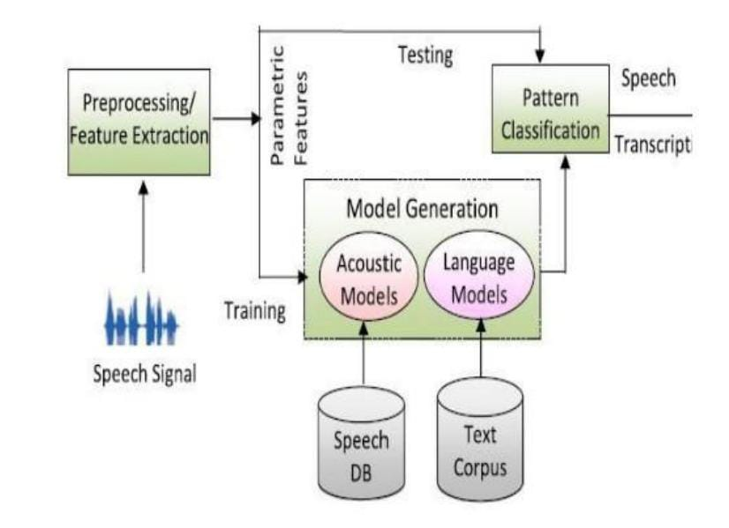
SYSTEM ARCHITECTURE

Slide 8
APPLICATIONS
In car systems
Usage in education and daily life
Amazon’s alexa
Google google’s assistant

Slide 9
HARDWARE REQUIREMENTS
System - Pentium 4 2.4 GHz
Hard Disk - 40 Gb
Floppy Drive - 1.44 Mb
Monitor - 15 VGA Colour
Mouse - Logitech
Ram - 512 Mb

Slide 10
SOFTWARE REQUIREMENTS
Operating System - Windows
Coding Language -Python
IDE -IDLE Python 3.8

Slide 11
MODULES
Python Speech Recognition module
Python webbrowser module
Python time module
Python playsound module
Python os module
Python gTTS module

Slide 12
PYTHON Speech Recognition MODULE
Library for performing speech recognition, with support for several engines and APIs, online and offline.
The first component of speech recognition is, of course, speech. Speech must be converted from physical sound to an electrical signal with a microphone, and then to digital data with an analog-to-digital converter.

Slide 13
PYTHON webbrowser MODULE
The webbrowser module provides a high-level interface to allow displaying Web-based documents to users.
Under most circumstances, simply calling the open() function from this module will do the right thing. You have to import the module and use open() function.

Slide 14
PYTHON time MODULE
This module provides various time-related functions. For related functionality, see also the datetime and calendar modules.
Although this module is always available, not all functions are available on all platforms.

Slide 15
PYTHON playsound MODULE
The playsound module is a cross platform module that can play audio files. This doesn't have any dependencies, simply install with pip in your virtual environment and run.
Implementation is different on platforms.

Slide 16
PYTHON os MODULE
The OS module in python provides functions for interacting with the operating system.
OS, comes under Python's standard utility modules.
This module provides a portable way of using operating system dependent functionality.
This modules include many functions to interact with the file system.

Slide 17
PYTHON gTTS MODULE
gTTS (Google Text-to-Speech), a Python library and CLI tool to interface with Google Translate text-to-speech API.
Writes spoken mp3 data to a file, a file-like object (bytestring) for further audio manipulation, or stdout.
It features flexible pre-processing and tokenizing.

Slide 18
REFERENCES
https://hackernoon.com/how-to-convert-speech-to-text-in-python-q0263tzp
http://www.igntu.ac.in/eContent/IGNTU-eContent-815947141046-MA-Linguistics-4-HarjitSingh-ComputationalLinguistics-5.pdf
https://pypi.org/project/SpeechRecognition/
https://pypi.org/project/pyttsx3/2.7/
https://pypi.org/project/PyAudio/

Slide 19
THANK YOU!!

